Slide 1

Midterm Exam Problems
Computer Networking: A Top-Down Approach 8th edition Jim Kurose, Keith Ross Pearson, 2020
Notes:
(8.2)Version
7.2 (January 2020)
All slides reformatted for 16:9 aspect ratio
Use of Calibri font, rather that Gill Sans MT
Updated slide content for 2020 link technologies and applications
Add more animation throughout
New Master slide
Feb. 2020 (8.0)
a few updates suggest by Catherine Rosenberg (thanks!)
titles in a lighter font
Sept 2020 (8.1)
Added ~7 new slides, in particular: data center slide; routing versus forwarding; security line of defense; several on encapsulation and layers (this section is a lot better now). Other relative minor changes throughout
Feb. 2023 (8.2)
few minor updates (mostly speeds, technology details)

Slide 2

Chapter 1: roadmap
What is the Internet?
What is a protocol?
Network edge: hosts, access network, physical media
Network core: packet/circuit switching, internet structure
Performance: loss, delay, throughput
Security
Protocol layers, service models

Slide 3

How do packet delay and loss occur?
IMPORTANT
packets queue in router buffers, waiting for turn for transmission
queue length grows when arrival rate to link (temporarily) exceeds output link capacity
packet loss occurs when memory to hold queued packets fills up
packet being transmitted (transmission delay)
A
B
packets in buffers (queueing delay)
free (available) buffers: arriving packets
dropped (loss) if no free buffers

Slide 4
Packet delay: four sources
IMPORTANT
transmission
A
propagation
B
nodal
processing
queueing
d_{nodal} = d_{proc} + d_{queue} + d_{trans} + d_{prop}
d_{proc}: nodal processing
check bit errors
determine output link
typically < microsecs
d_{queue}: queueing delay
time waiting at output link for transmission
depends on congestion level of router

Slide 5
Packet delay: four sources
IMPORTANT
transmission
A
propagation
B
nodal
processing
queueing
d_{nodal} = d_{proc} + d_{queue} + d_{trans} + d_{prop}
d_{trans}: transmission delay:
L: packet length (bits)
R: link transmission rate (bps)
d_{trans} = L/R
d_{prop}: propagation delay:
d: length of physical link
s: propagation speed (~2x10⁸ m/sec)
d_{prop} = d/s
d_{trans} and d_{prop}
very different

Slide 6
Throughput
IMPORTANT
throughput: rate (bits/time unit) at which bits are being sent from sender to receiver
instantaneous: rate at given point in time
average: rate over longer period of time
link capacity
R_{s} bits/sec
link capacity
R_{c} bits/sec
pipe that can carry
fluid at rate
(R_{s} bits/sec)
pipe that can carry
fluid at rate
(R_{c} bits/sec)
server sends bits
(fluid) into pipe
server, with
file of F bits
to send to client

Slide 7
Throughput
IMPORTANT
R_{s} < R_{c} What is average end-end throughput?
R_{s} bits/sec
R_{c} bits/sec
R_{s} > R_{c} What is average end-end throughput?
R_{s} bits/sec
R_{c} bits/sec
bottleneck link
link on end-end path that constrains end-end throughput

Slide 8
Throughput: network scenario
IMPORTANT
per-connection end-end throughput: min(R_{c},R_{s},R/10)
in practice: R_{c} or R_{s} is often bottleneck
Link utilization: used bandwidth/available bandwidth. For the three links:
min(R_{c},R_{s},R/10)/R_{s}
min(R_{c},R_{s},R/10)/(R/10)
min(R_{c},R_{s},R/10)/R_{c}
R_{s}
R_{s}
R_{s}
R
R_{c}
R_{c}
R_{c}
10 connections (fairly) share backbone bottleneck link R bits/sec
* Check out the online interactive exercises for more examples: http://gaia.cs.umass.edu/kurose_ross/

Slide 9
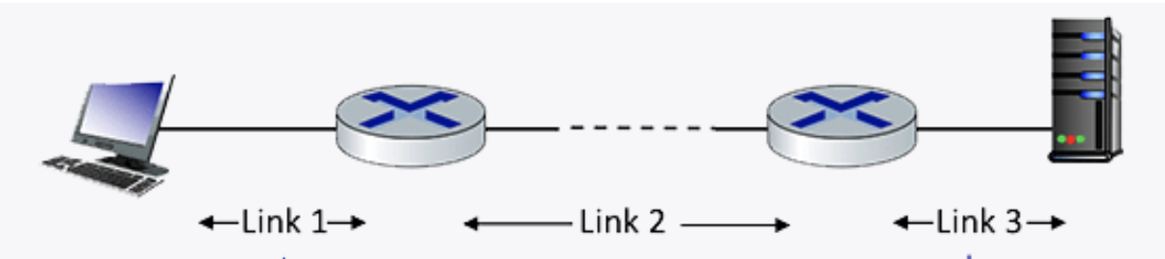
Midterm Question 1.4-01a
1.4-01a. Performance: Delay. Consider the network shown in the figure below, with three links, each with a transmission rate of 1 Mbps, and a propagation delay of 1 msec per link. Assume the length of a packet is 1000 bits.
What is the end-end delay of a packet from when it first begins transmission on link 1, until is it received in full by the server at the end of link 3. You can assume that queueing delays and packet processing delays are zero, but make sure you include packet transmission time delay on all links. Assume store-and forward packet transmission.
Each link has transmission delay 1000 bits/1 Mbps = 1ms. So each link has total delay of transmission + propagation = 1+1=2 ms.
For the three links, the total delay = 2 + 2 + 2 = 6 ms. `

Slide 10
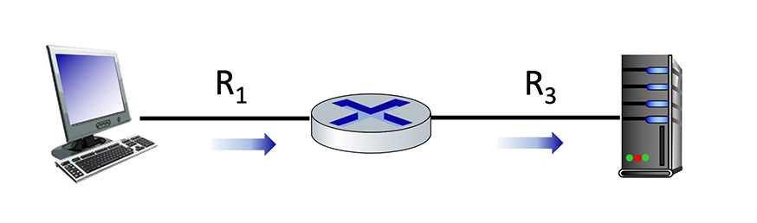
Midterm Question 1.4-01b
Maximum end-end throughput. Consider the scenario shown below, with a single source client sending to a server over two links of capacities R1=100 Mbps and R3=10 Mbps.
What is the maximum achievable end-end throughput (in Mbps, give an integer value) for the client-to-server pair, assuming that the client is trying to send at its maximum rate?
min (R1, R3) = min (100, 10) = 10 Mpbs.

Slide 11
Midterm Question 1.4-01c
Performance: Maximum end-end throughput. Consider the scenario shown below, with a single source client sending to a server over two links of capacities R1=10 Mbps and R3=100 Mbps.
What is the maximum achievable end-end throughput (in Mbps, give an integer value) for the client-to-server pair, assuming that the client is trying to send at its maximum rate?
min (R1, R3) = min (10, 100) = 10 Mpbs.

Slide 12
Midterm Question 1.4-01c
Performance: Maximum end-end throughput. Consider the scenario shown below, with a single source client sending to a server over two links of capacities R1=10 Mbps and R3=100 Mbps.
What is the maximum achievable end-end throughput (in Mbps, give an integer value) for the client-to-server pair, assuming that the client is trying to send at its maximum rate?
min (R1, R3) = min (10, 100) = 10 Mpbs.

Slide 13
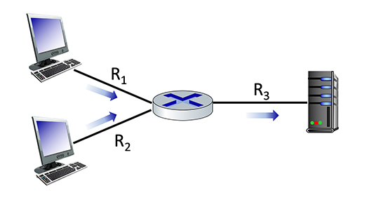
Midterm Question 1.4-01d
IMPORTANT
100 Mbps
10 Mbps
1.4-01e. Performance: Maximum end-end throughput. Consider the scenario shown below, with two clients sending to a server. The links attached to clients each have a capacity of R1= R2 = 100 Mbps. The link from the router to the server has a capacity of and R3 = 10 Mbps, which is shared evenly between the two sources when they are each sending at their maximum rate.
What is the maximum achievable end-end throughput (in Mbps, give an integer value) for each client-to-server pair, assuming that the client is trying to send at its maximum rate?
100 Mbps
The maximum achievable end-end throughput is min (R1, R3/2) = min (R2, R3/2) = min (100, 10/2) = 5 Mbps.
The shared 100 Mbps link is fairly shared among two end-to-end connections (R1, R3) and (R2, R3), hence each end-to-end connection gets 10/2=5 Mbps.
Notes:
The link bandwidth is independent of the transmission direction.

Slide 14
Midterm Question 1.4-01e
IMPORTANT
10 Mbps
100 Mbps
1.4-01e. Performance: Maximum end-end throughput. Consider the scenario shown below, with two clients sending to a server. The links attached to clients each have a capacity of R1= R2 = 10 Mbps. The link from the router to the server has a capacity of and R3 = 100 Mbps, which is shared evenly between the two sources when they are each sending at their maximum rate.
What is the maximum achievable end-end throughput (in Mbps, give an integer value) for each client-to-server pair, assuming that the client is trying to send at its maximum rate?
10 Mbps
The maximum achievable end-end throughput is min (R1, R3/2) = min (R2, R3/2) = min (10, 100/2) = 10 Mbps.
The shared 100 Mbps link is fairly shared among two end-to-end connections (R1, R3) and (R2, R3), hence each end-to-end connection gets 100/2=50 Mbps.
Note that min (R1, R2, R3/2) is incorrect, since R1 and R2 are on deferent end-to-end connections.
Remember that parallel links should never be put into the min() formula, only sequential links forming the same end-to-end connection should be in the same min() formula.
Notes:
The link bandwidth is independent of the transmission direction.

Slide 15
Midterm Question 1.4-01e variation
IMPORTANT
10 Mbps
100 Mbps
1.4-01e. Performance: Maximum end-end throughput. Consider the scenario shown below, with two clients sending to a server. The links attached to clients each have a capacity of R1 = 10 Mbps, R2 = 20 Mbps. The link from the router to the server has a capacity of and R3 = 100 Mbps, which is shared evenly between the two sources when they are each sending at their maximum rate.
What is the maximum achievable end-end throughput (in Mbps, give an integer value) for each client-to-server pair, assuming that the client is trying to send at its maximum rate?
20 Mbps
For client on top, the maximum achievable end-end throughput is min (R1, R3/2) = min (10, 100/2) = 10 Mbps.
For client on bottom, the maximum achievable end-end throughput is min (R1, R3/2) = min (20, 100/2) = 20 Mbps.
The shared 100 Mbps link is fairly shared among two end-to-end connections (R1, R3) and (R2, R3), hence each end-to-end connection gets 100/2=50 Mbps.
Notes:
The link bandwidth is independent of the transmission direction.

Slide 16
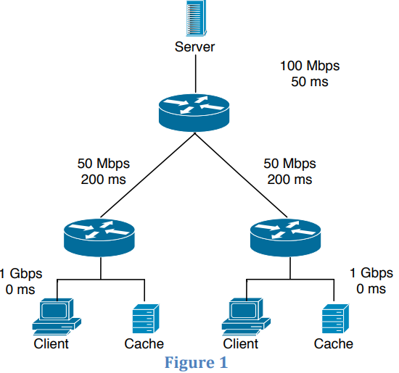
Midterm Question 1.4-02a
Consider the scenario shown in Figure 1 in which a server is connected to a router by a 100Mbps link with a 50ms propagation delay. Initially this router is also connected to two routers, each over a 50Mbps link with a 200ms propagation delay. A 1Gbps link connects a host and a cache (if present) to each of these routers and we assume that this link has 0 propagation delay. All packets in the network are 20,000 bits long.
What is the end-­to­‐end delay (in msec) from when a packet is transmitted by the server to when it is received by the client? In this case, we assume there are no caches, there’s no queuing delay at the routers, and the packet processing delays at routers and nodes are all 0.
ANS: If all packets are 20,000 bits long it takes 200 usec to send the packet over the 100Mbps link, 400 usec to send over the 50Mbps link, and 20 usec to send over the 1Gbps link.
Sum of the three-link transmission is 620 usec. Thus, the total end-to-end delay is 250 ms + 620 usec = 250.62 msec.

Slide 17
Midterm Question 1.4-02b
Here we assume that client hosts send requests for files directly to the server (caches are not used or off in this case). What is the maximum rate at which the server can deliver data to a single client if we assume no other clients are making requests?
Server can send at the max of the bottleneck link bandwidth min(100/2 Mbps, 50 Mbps, 1 Gbps) = 50 Mbps, since the top link is shared and the other two links are separate for each client and not shared.
Suppose we had 10 clients on the bottom, then the bottleneck link bandwidth min(100/10 Mbps, 50 Mbps, 1 Gbps) = 10 Mbps.

Slide 18
Midterm Question 1.4-02c
Again we assume only one active client but in this case the caches are on and behave like HTTP caches. A client’s HTTP GET is always first directed to its local cache. 60% of the requests can be satisfied by the local cache. What is the average rate at which the client can receive data in this case?
60% of the requests can be satisfied by the local cache, with bandwidth of 1 Gbps = 1000 Mpbs.
40% of the requests go to the remote server, with bandwidth of min (100 Mbps, 50 Mbps, 1Gbps) = 50 Mpbs.
Since we assume only one active client, we do not have 100/2 as the first term.
The average rate at which the client can receive data is .4*50+.6*1000=620 Mbps

Slide 19
Midterm Question 1.4-02d
Now clients in both LANs are active and the both caches are on. 60% of the requests can be satisfied by the local caches. What is the average rate at which each client can receive data?
60% of the requests can be satisfied by the local cache, with bandwidth of 1 Gbps = 1000 Mpbs.
40% of the requests go to the remote server, with bandwidth of min (100/2 Mbps, 50 Mbps, 1Gbps) = 50 Mpbs.
Since we both clients are active, we have 100/2 as the first term.
The average rate at which the client can receive data is .4*50+.6*1000=620 Mbps

Slide 20
Network layer: “data plane” roadmap
Network layer: overview
data plane
control plane
What’s inside a router
input ports, switching, output ports
buffer management, scheduling
IP: the Internet Protocol
datagram format
addressing
network address translation
IPv6
Generalized Forwarding, SDN
Match+action
OpenFlow: match+action in action
Middleboxes

Slide 21
Packet Scheduling: FCFS
IMPORTANT
packet scheduling: deciding which packet to send next on link
first come, first served
priority
round robin
weighted fair queueing
FCFS: packets transmitted in order of arrival to output port
also known as: First-in-first-out (FIFO)
real world examples?
Abstraction: queue
R
packet
departures
packet
arrivals
queue
(waiting area)
link
(server)

Slide 22
Scheduling policies: priority
IMPORTANT
Priority scheduling:
arriving traffic classified, queued by class
any header fields can be used for classification
high priority queue
arrivals
classify
link
departures
low priority queue
2
send packet from highest priority queue that has buffered packets
FCFS within priority class
1
3
4
5
arrivals
packet in service
1
3
2
4
5
departures
1
3
2
4
5

Slide 23
Scheduling policies: round robin
IMPORTANT
Round Robin (RR) scheduling:
arriving traffic classified, queued by class
any header fields can be used for classification
server cyclically, repeatedly scans class queues, sending one complete packet from each class (if available) in turn
R
classify
arrivals
link
departures

Slide 24
Scheduling policies: weighted fair queueing
IMPORTANT
Weighted Fair Queuing (WFQ):
generalized Round Robin
each class, i, has weight, w_{i}, and gets weighted amount of service in each cycle:
w₁
w₂
R
w_{i}
Σ_{j}w_{j}
classify
arrivals
link
departures
w₃
minimum bandwidth guarantee (per-traffic-class)

Slide 25
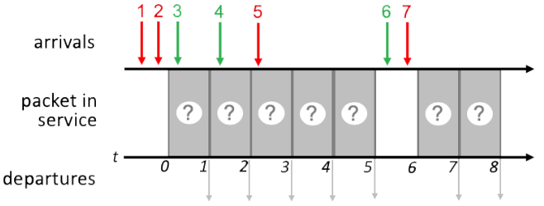
Quiz 1 4.2-7
IMPORTANT

Slide 26
Quiz 1 4.2-7a FCFS Scheduling
IMPORTANT
Transmit order the same as packet arrival order of 1 2 3 4 5 6 7
1
2
3
4
5
6
7
1
2
3
4
5
6
7
1 2 3 4 5 6 7

Slide 27
Quiz 1 4.2-7b Priority Scheduling
IMPORTANT
Time 0: 1, 2 in queue, transmit 1
FCFS within same priority
Time 1: 2, 3 in queue, transmit 2
Time 2: 3, 4 in queue, transmit 3
FCFS within same priority
Time 3: 4, 5 in queue, transmit 5
Time 4: 4 in queue, transmit 4
Time 6: 6, 7 in queue, transmit 7
Time 7: 6 in queue, transmit 6
1
2
3
5
4
7
6
1
2
3
5
4
7
6
1 2 3 5 4 7 6
Network Layer: 4-27

Slide 28
Quiz 1 4.2-7c Round Robin Scheduling
IMPORTANT
Assume a round-robin scheduling cycle begins with red packets. i.e., (red, green) in each round.
Time 0: 1, 2 in queue, transmit 1
1st round of (red, green)
Time 1: 2, 3 in queue, transmit 3
1st round of (red, green)
Time 2: 2. 4 in queue, transmit 2
2nd round of (red, green)
Time 3: 4, 5 in queue, transmit 4
2nd round of (red, green)
Time 4: 5 in queue, transmit 5
3RD round of (red, green). Since there is no green packet ready, this round is (red, null)
Time 6: 6, 7 in queue, transmit 7
4th round of (red, green)
Time 7: 6 in queue, transmit 6
4th round of (red, green)
Summary:
Times 0-1: 1st round: (1, 3)
Times 2-3: 2nd round: (2, 4)
Time 4: 3rd round: (5, null)
No green packets ready
Times 6-7: 4th round: (7, 6)
1
3
2
4
5
7
6
1
3
2
4
5
7
6
1 3 2 4 5 7 6

